Slide 1
Artificial Intelligence (Machine Learning & Deep Learning)
{
Multivariate Linear Regression
}
...

Slide 2
Contents of Day 23
Recap & introduction | Moving from Python OOP to Data Science & Machine Learning.
Core Thoery | Logistic Regression (Binary Classification). Predicting Categories (0 or 1), Not Continuous Numbers. The Sigmoid Activation Function.
Lab Practice | Practical coding tasks implementing method
Advance Lab | Understanding the logic with real world examples.
Wrap-up & Q&A | Debugging tips along with Q&A and suggestion

Slide 3
From Numbers to Categories
Last lesson: We predicted continuous numbers (house price = $350k).
Today: We predict categories (Safe or DDoS Attack, Spam or Legitimate).
Challenge: How do you force a model to output only 0 or 1?
The answer: The Sigmoid function.

Slide 4
The Classification Problem
Linear Regression:
Predicts continuous values (any number).
Server load at 85.5%, house price at $350,127, temperature at 72.3°C.
Binary Classification:
Predicts strict categories (only 0 or 1).
Safe traffic [0] or DDoS attack [1].
Spam email [0] or legitimate [1].
Approved [0] or rejected [1].
We moved from "how much" to "which one."

Slide 5
Why Linear Regression Fails at Classification
Linear Regression draws a straight line through data.
The Problem:
A straight line has no boundaries.
It predicts impossible values: -5, +10, +999.
But probabilities must be 0% to 100% (0.0 to 1.0).
Example:
Linear model predicts: -2.5 (impossible as probability)
Linear model predicts: +8.3 (impossible as probability)
A straight line is the wrong tool for classification.

Slide 6
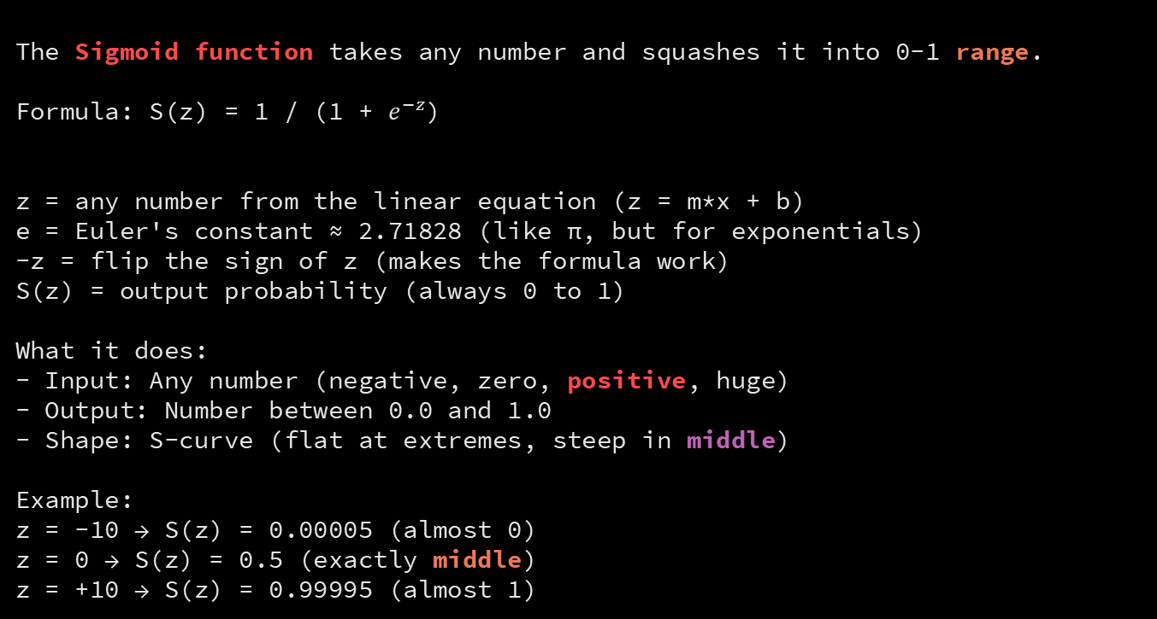
The Sigmoid Function - The Solution
The Sigmoid function takes any number and squashes it into 0-1 range.
Formula: S(z) = 1 / (1 + $e^{−z}$)
z = any number from the linear equation (z = m*x + b)
e = Euler's constant ≈ 2.71828 (like π, but for exponentials)
-z = flip the sign of z (makes the formula work)
S(z) = output probability (always 0 to 1)
What it does:
- Input: Any number (negative, zero, positive, huge)
- Output: Number between 0.0 and 1.0
- Shape: S-curve (flat at extremes, steep in middle)
Example:
z = -10 → S(z) = 0.00005 (almost 0)
z = 0 → S(z) = 0.5 (exactly middle)
z = +10 → S(z) = 0.99995 (almost 1)

Slide 7
Visualizing the Sigmoid Curve
The Sigmoid is an S-shaped curve.
Left side (z < 0):
Prediction approaches 0.
Predicted class: 0 (Safe, Legitimate, Approved).
Middle (z = 0):
Prediction exactly 0.5.
Decision boundary.
Right side (z > 0):
Prediction approaches 1.
Predicted class: 1 (DDoS, Spam, Rejected).
The curve has no sharp edges - smooth transition from 0 to 1.

Slide 8
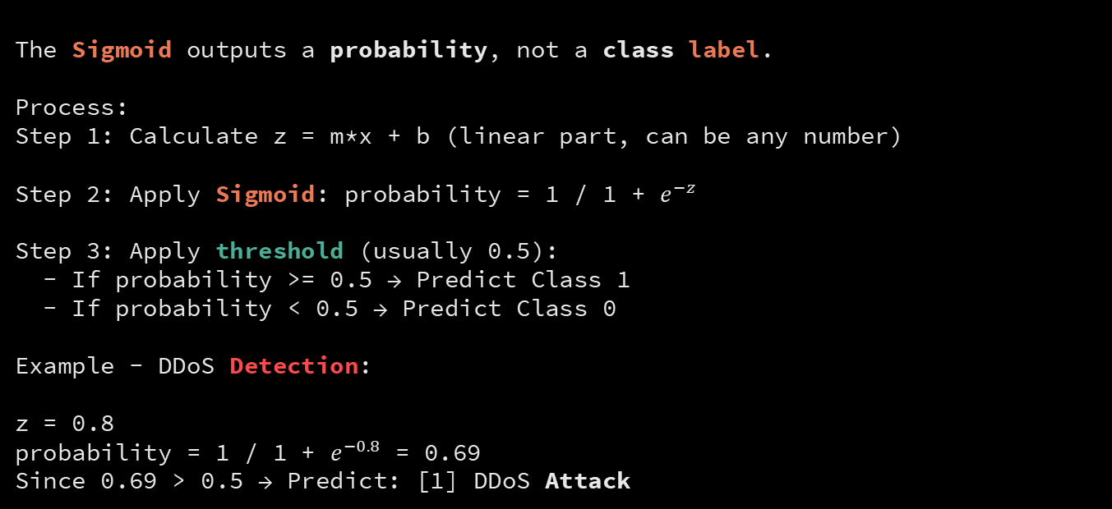
From Probability to Classification
The Sigmoid outputs a probability, not a class label.
Process:
Step 1: Calculate z = m*x + b (linear part, can be any number)
Step 2: Apply Sigmoid: probability = 1 / 1 + $e^{−z}$
Step 3: Apply threshold (usually 0.5):
- If probability >= 0.5 → Predict Class 1
- If probability < 0.5 → Predict Class 0
Example - DDoS Detection:
z = 0.8
probability = 1 / 1 + $e^{−0.8}$ = 0.69
Since 0.69 > 0.5 → Predict: [1] DDoS Attack

Slide 9
The Cost Function Changes
Linear Regression Cost Function:
MSE = (1/n) × Σ(predicted - actual)²
Logistic Regression Cost Function:
Binary Cross-Entropy = -(1/n) × Σ[y*log(p) + (1-y)*log(1-p)]
Why change?
MSE works for continuous values.
Cross-Entropy works for probabilities and categories.
It penalizes confident wrong predictions more than uncertain ones.

Slide 10
Gradient Descent Still Works
Good news: Gradient Descent remains unchanged.
We still:
Step 1: Calculate predictions (now using Sigmoid)
Step 2: Calculate cost (now using cross-entropy)
Step 3: Calculate gradients
Step 4: Update weights (m and b)
The algorithm is the same.
Only the hypothesis and cost function changed.
Everything you learned about optimization applies here.

Slide 11
Real Example - Spam Email Detection
Data: 10,000 historical emails
X = email features (number of links, sender reputation, keyword frequency)
y = label (0 = Legitimate, 1 = Spam)
Model learns:
m and b values that separate legitimate from spam emails.
Prediction on new email:
z = 2.5*links + 0.1*reputation + 1.2*keywords + bias
probability = 1 / (1 + e^(-z)) = 0.87
Since 0.87 > 0.5 → Classify: [1] SPAM

Slide 12
Summary - The Big Picture
Linear Regression predicted numbers (continuous output).
Logistic Regression predicts categories (binary 0 or 1 output).
The Sigmoid function is the secret: it squashes any number into 0-1 range.
Gradient Descent still optimizes the weights.
Only the hypothesis (Sigmoid) and cost function (cross-entropy) are different.
Next: Implement logistic regression in Python and train a real classifier.

Slide 13
Thank You for Your Focus Today!
What was the most confusing part of today's lab?
Waleed Khan (Robotics Engineer | Senior Python Developer)
Email: 0xcloudcoder@gmail.com Contact: +923126008702
}
*

